Slide 1










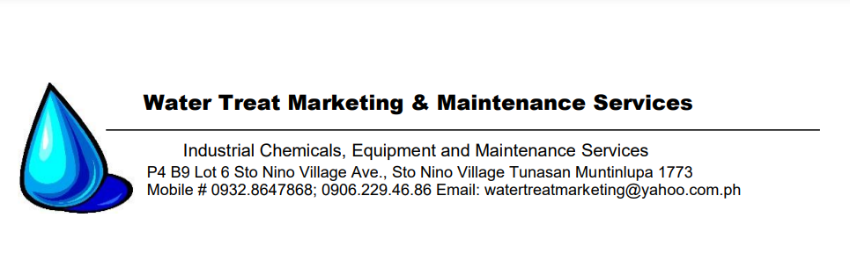

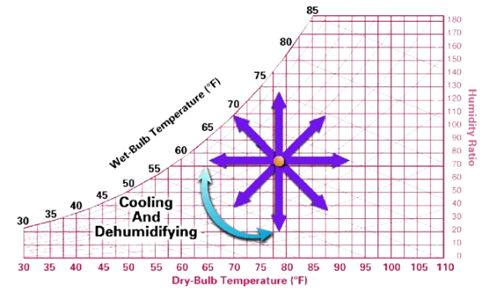
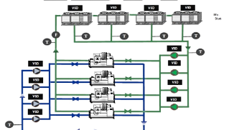
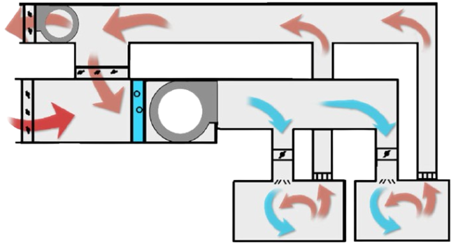








Duct Design Manual Calculation
(Air Distribution System)
Follow me on LinkedIn
Scan the code using
LinkedIn Mobile
Engr. NICK JOHNSONN FERNANDEZ
Technical Committee Member, PSIM Makati
Partner Consultant, RBSanchez PME Consultants and Associates, Inc.
Technical Design & Operations Consultant, Metallurgical and Mining
PSIM Makati HVAC Series | TECHNICAL SEMINAR
March 9,16,23 and April 13
PHILIPPINE TRADE TRAINING CENTER, PASAY CITY
Education/Study Tour Venue:
Vista Mall Sta Rosa
Technical Seminar Partners:

Slide 2

About the Speaker
Worked as a freelance mechanical designer, modeler, and researcher for a variety of local and international companies since 2013.
Graduated with a BS in Mechanical Engineering from President Ramon Magsaysay State University in 2018.
Started my professional career in 2018 at RBSanchez PME Consultants and Associates, Inc.
Currently, Independent Design and Operations Consultant for Various Industrial and Mining Companies
PSIM Makati HVAC Series | TECHNICAL SEMINAR
March 9,16,23 and April 13
PHILIPPINE TRADE TRAINING CENTER, PASAY CITY
Education/Study Tour Venue:
Vista Mall Sta Rosa

Slide 3
About the Speaker
Currently, Partner Consultant and the former Director of Engineering & Numerical Simulations — Onshore and Offshore at RBSanchez PME Consultants
Handled and led various multi-discipline (i.e., MEP, civil, geological, mining and metallurgical) critical projects for RBSanchez PME.
Member, ASHRAE
PSIM Makati HVAC Series | TECHNICAL SEMINAR
March 9,16,23 and April 13
PHILIPPINE TRADE TRAINING CENTER, PASAY CITY
Education/Study Tour Venue:
Vista Mall Sta Rosa

Slide 4
About the Speaker
Team Member – Applications Engineer at Digital Creatives Worldwide since 2022
Autodesk Certified Instructor (ACI)
Autodesk Certified User: AutoCAD and Autodesk Inventor
PSIM Makati HVAC Series | TECHNICAL SEMINAR
March 9,16,23 and April 13
PHILIPPINE TRADE TRAINING CENTER, PASAY CITY
Education/Study Tour Venue:
Vista Mall Sta Rosa

Slide 5
About the Speaker
Distant Learning Specializations
MicroMasters Course in Optimization Principles and Algorithms, Swiss Federal Institute of Technology
Professional Degree Course in Data Science and Analytics PH125.x, HarvardX
Data Science and Analytics Specialization, John Hopkins University
Sustainable Building Design MIT4.464x, MITx
PSIM Makati HVAC Series | TECHNICAL SEMINAR
March 9,16,23 and April 13
PHILIPPINE TRADE TRAINING CENTER, PASAY CITY
Education/Study Tour Venue:
Vista Mall Sta Rosa

Slide 6
Learning Objectives:
To learn the theories and principle of duct design
To learn the basics of duct design, computation of external static pressure (ESP), pressure losses.
To learn how to use friction charts for friction loss determination
To learn how to use various software to determine friction loss such as spreadsheets, duct sizers, and ASHRAE databases.
PSIM Makati HVAC Series | TECHNICAL SEMINAR
March 9,16,23 and April 13
PHILIPPINE TRADE TRAINING CENTER, PASAY CITY
Education/Study Tour Venue:
Vista Mall Sta Rosa

Slide 7
Introduction to Duct Design
Ducts in air distribution systems are designed to transport volume of air as efficiently and quietly as possible to minimize energy consumption and excessive noise.
Duct designs are also intricate in the sense where proper layout of the system and terminals are important to deliver the air minimizing the air stagnation (“age of air”) over the space.
PSIM Makati HVAC Series | TECHNICAL SEMINAR
March 9,16,23 and April 13
PHILIPPINE TRADE TRAINING CENTER, PASAY CITY
Education/Study Tour Venue:
Vista Mall Sta Rosa

Slide 8
Important Aspects of Duct System Design
Duct Layout
Fittings
Leakage
Acoustics
Equipment Selection
PSIM Makati HVAC Series | TECHNICAL SEMINAR
March 9,16,23 and April 13
PHILIPPINE TRADE TRAINING CENTER, PASAY CITY
Education/Study Tour Venue:
Vista Mall Sta Rosa

Slide 9
Main Goals of Duct Design
To design energy-efficient HVAC system while minimizing the capital (first) cost and operational expenses.
To provide comprehensive design and a high-quality project with minimum construction cost.
PSIM Makati HVAC Series | TECHNICAL SEMINAR
March 9,16,23 and April 13
PHILIPPINE TRADE TRAINING CENTER, PASAY CITY
Education/Study Tour Venue:
Vista Mall Sta Rosa

Slide 10
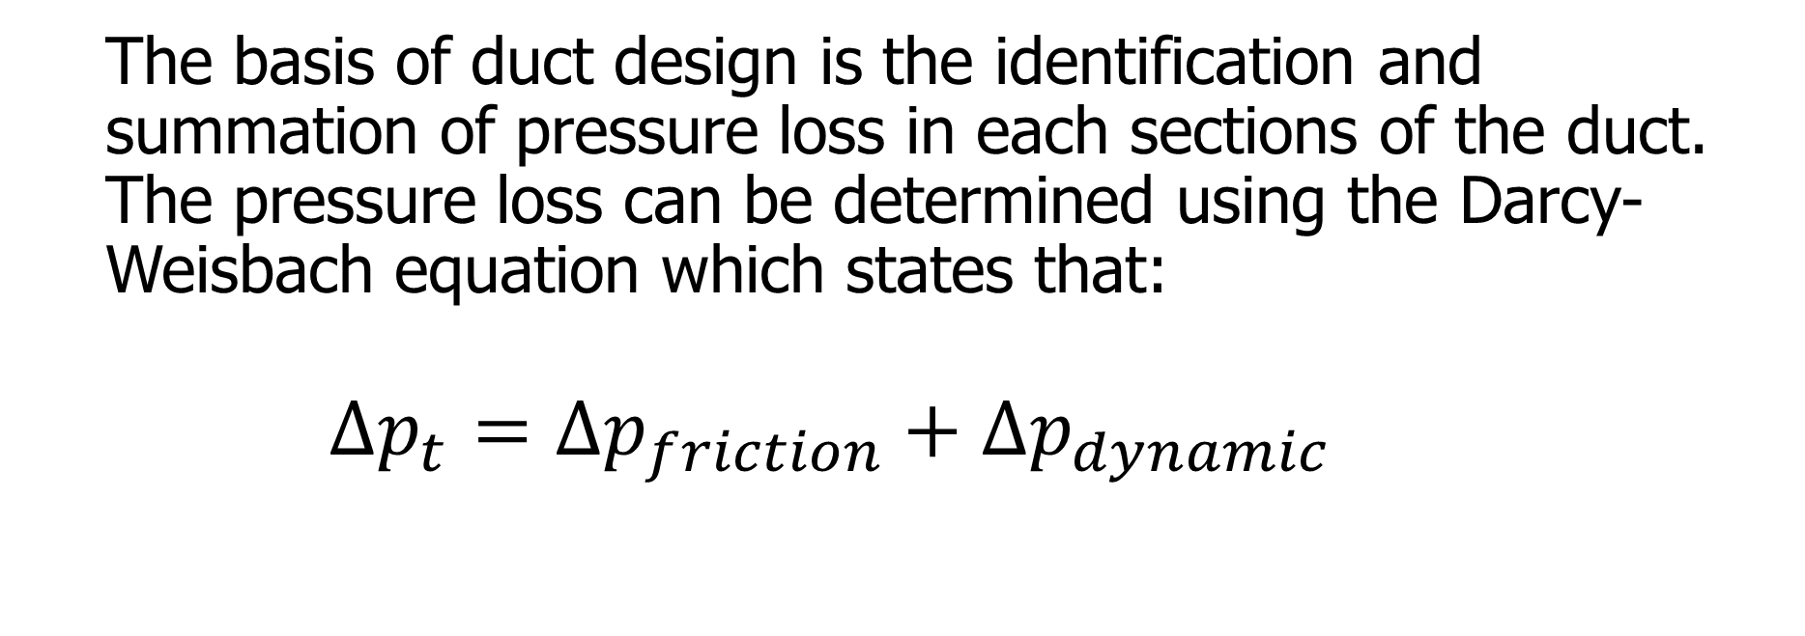
Pressure Loss
The basis of duct design is the identification and summation of pressure loss in each sections of the duct. The pressure loss can be determined using the Darcy-Weisbach equation which states that:
$$∆p_{t}=∆p_{friction}+∆p_{dynamic}$$
PSIM Makati HVAC Series | TECHNICAL SEMINAR
March 9,16,23 and April 13
PHILIPPINE TRADE TRAINING CENTER, PASAY CITY
Education/Study Tour Venue:
Vista Mall Sta Rosa

Slide 11
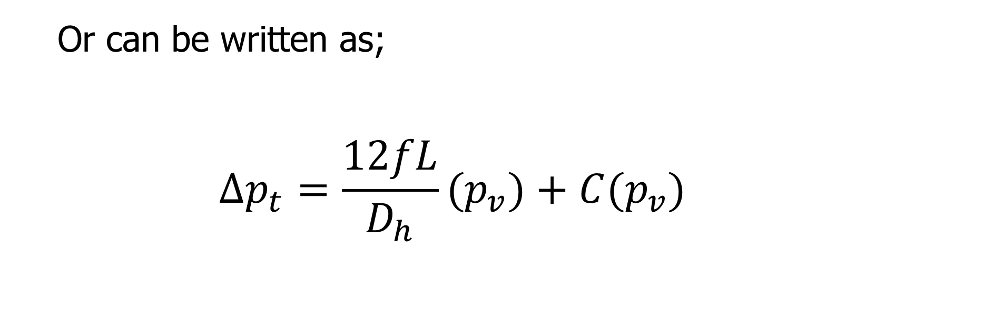
Pressure Loss
Or can be written as;
$$∆p_{t}=\frac{12fL}{D_{h}}{(p}_{v})+C{(p}_{v})$$
Resistance to air flow due to friction
Dynamic losses due to velocity
PSIM Makati HVAC Series | TECHNICAL SEMINAR
March 9,16,23 and April 13
PHILIPPINE TRADE TRAINING CENTER, PASAY CITY
Education/Study Tour Venue:
Vista Mall Sta Rosa

Slide 12
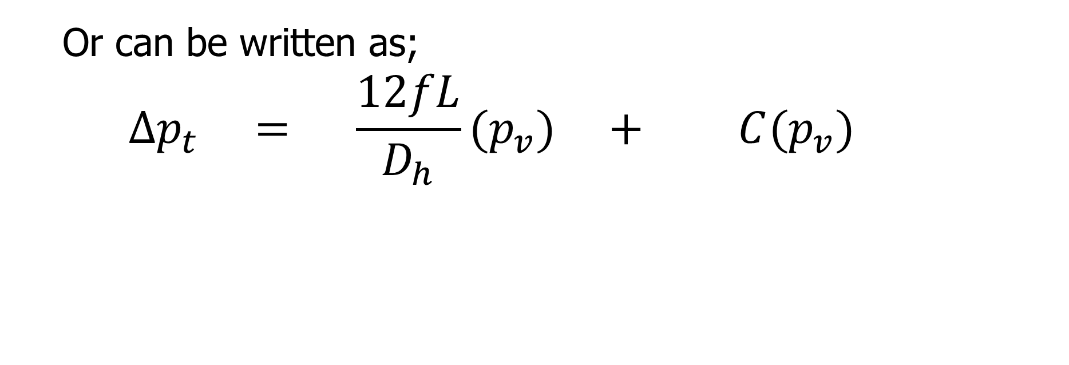
Pressure Loss
Or can be written as;
$$∆p_{t} = \frac{12fL}{D_{h}}{(p}_{v}) + C{(p}_{v})$$
Darcy
Weisbach
It can be calculated by hand
Friction chart
Duct fitting database
It can be calculated by hand
PSIM Makati HVAC Series | TECHNICAL SEMINAR
March 9,16,23 and April 13
PHILIPPINE TRADE TRAINING CENTER, PASAY CITY
Education/Study Tour Venue:
Vista Mall Sta Rosa

Slide 13
Conservation of Mass
Conservation of Energy
PSIM Makati HVAC Series | TECHNICAL SEMINAR
March 9,16,23 and April 13
PHILIPPINE TRADE TRAINING CENTER, PASAY CITY
Education/Study Tour Venue:
Vista Mall Sta Rosa

Slide 14
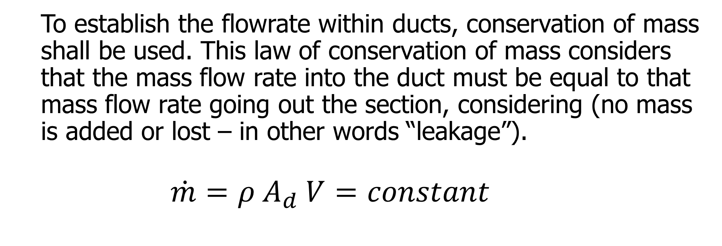
Conservation of Mass
To establish the flowrate within ducts, conservation of mass shall be used. This law of conservation of mass considers that the mass flow rate into the duct must be equal to that mass flow rate going out the section, considering (no mass is added or lost – in other words “leakage”).
$$\dot{m}=ρ A_{d} V=constant$$
PSIM Makati HVAC Series | TECHNICAL SEMINAR
March 9,16,23 and April 13
PHILIPPINE TRADE TRAINING CENTER, PASAY CITY
Education/Study Tour Venue:
Vista Mall Sta Rosa

Slide 15
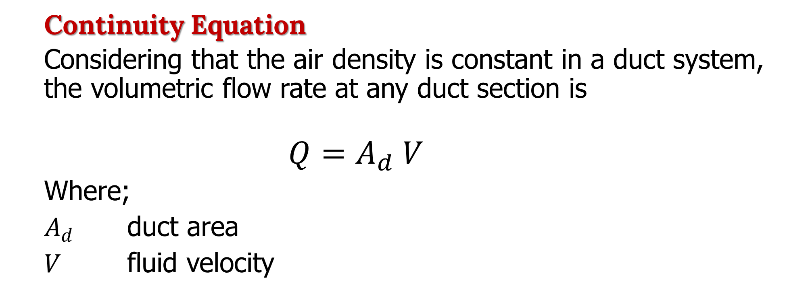
Conservation of Mass:
Continuity Equation
Considering that the air density is constant in a duct system, the volumetric flow rate at any duct section is
$$Q=A_{d} V$$
Where;
$A_{d}$ duct area
$V$ fluid velocity
PSIM Makati HVAC Series | TECHNICAL SEMINAR
March 9,16,23 and April 13
PHILIPPINE TRADE TRAINING CENTER, PASAY CITY
Education/Study Tour Venue:
Vista Mall Sta Rosa

Slide 16
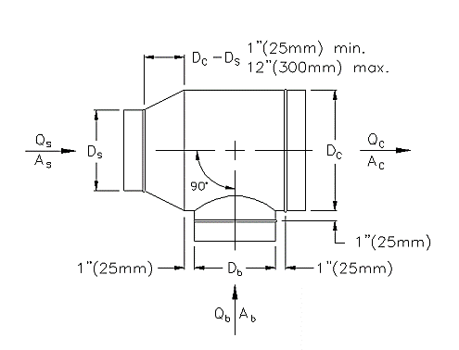
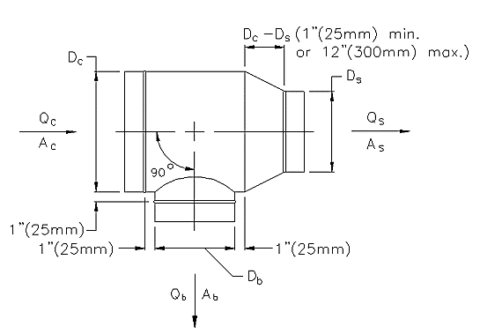
Conservation of Mass:
Diverging Flow
Converging Flow
PSIM Makati HVAC Series | TECHNICAL SEMINAR
March 9,16,23 and April 13
PHILIPPINE TRADE TRAINING CENTER, PASAY CITY
Education/Study Tour Venue:
Vista Mall Sta Rosa

Slide 17
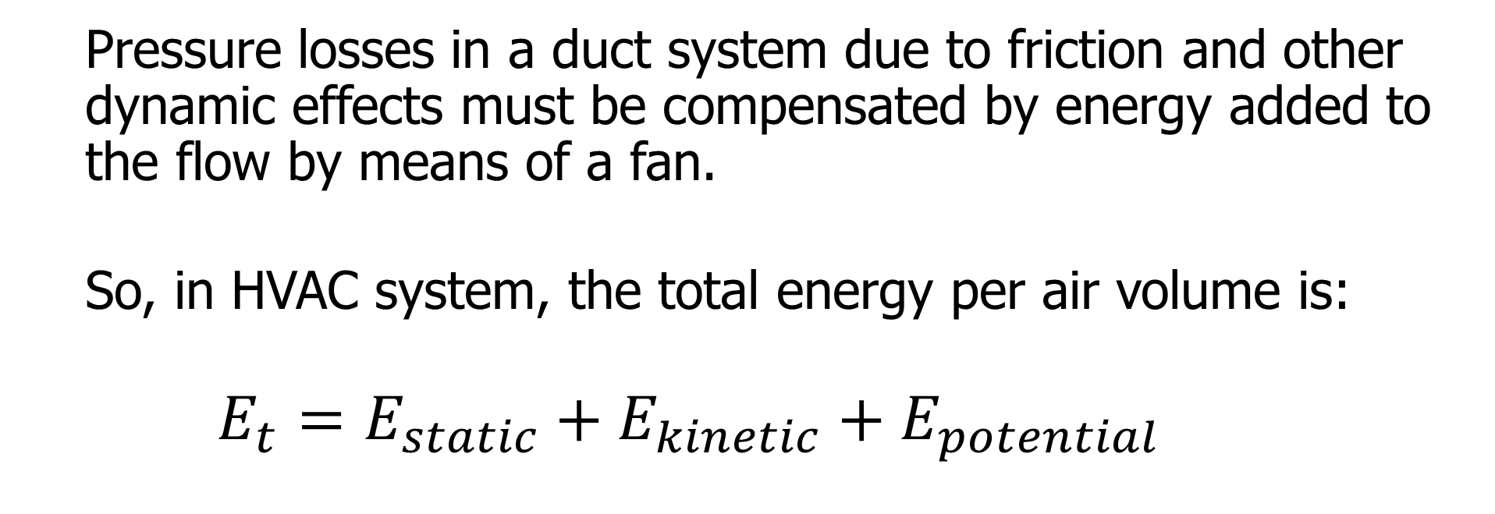
Conservation of Energy
Pressure losses in a duct system due to friction and other dynamic effects must be compensated by energy added to the flow by means of a fan.
So, in HVAC system, the total energy per air volume is:
$$E_{t}=E_{static}+E_{kinetic}+E_{potential}$$
PSIM Makati HVAC Series | TECHNICAL SEMINAR
March 9,16,23 and April 13
PHILIPPINE TRADE TRAINING CENTER, PASAY CITY
Education/Study Tour Venue:
Vista Mall Sta Rosa

Slide 18
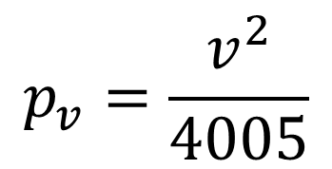
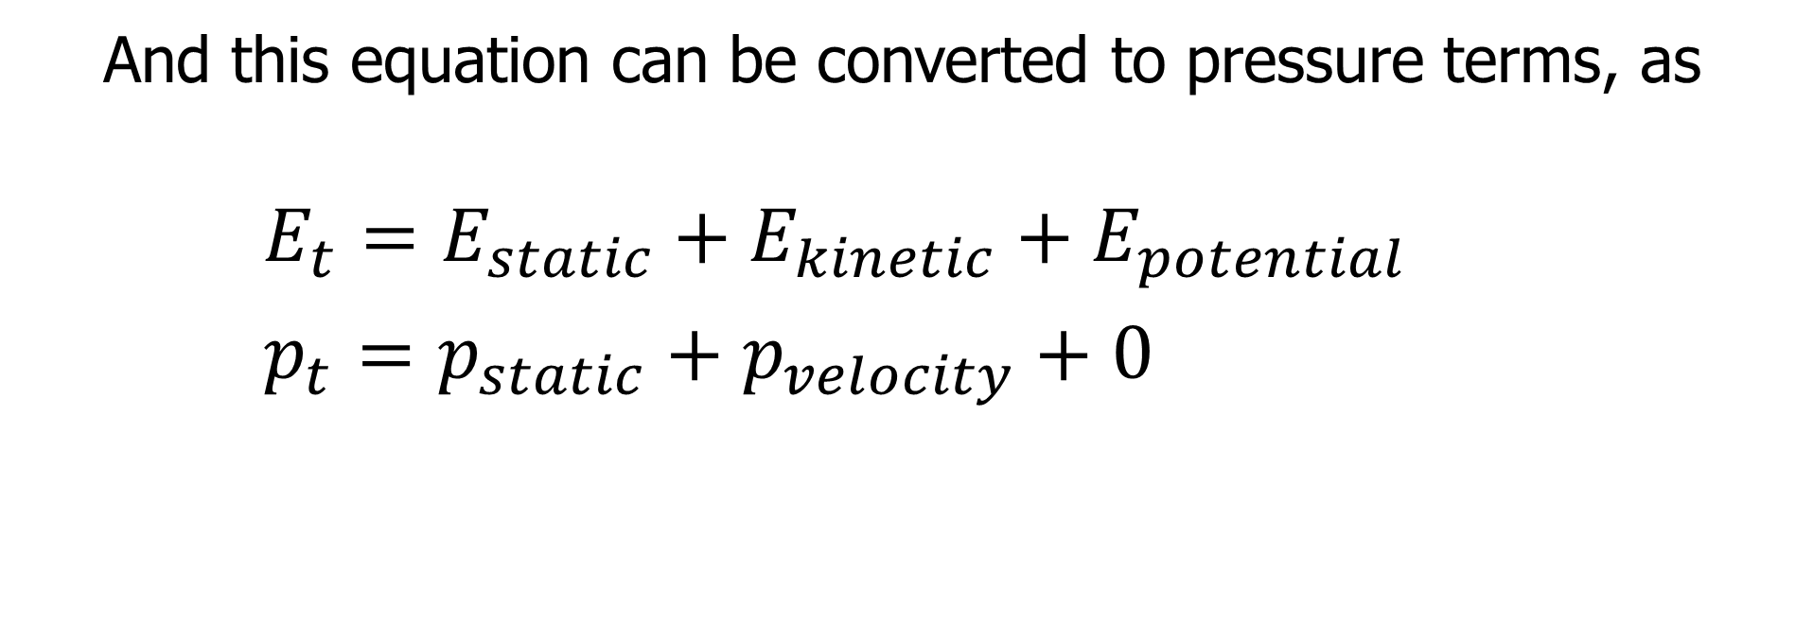
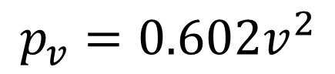
Conservation of Energy
And this equation can be converted to pressure terms, as
$$E_{t}=E_{static}+E_{kinetic}+E_{potential} \\ p_{t}=p_{static}+p_{velocity}+0$$
$$p_{v}=\frac{v^{2}}{4005}$$
$$p_{v}=0.602v^{2}$$
METRIC
U.S.
PSIM Makati HVAC Series | TECHNICAL SEMINAR
March 9,16,23 and April 13
PHILIPPINE TRADE TRAINING CENTER, PASAY CITY
Education/Study Tour Venue:
Vista Mall Sta Rosa

Slide 19
Conservation of Energy
For air to move, a pressure differential must exist.
Air moves from high to low pressure area. For example, a fan inlet is a negative pressure area, and the fan outlet is a positive pressure area.
Positive pressure flows are also called “supply air”;
Negative pressure flows are also called “exhaust” or “return air”.
PSIM Makati HVAC Series | TECHNICAL SEMINAR
March 9,16,23 and April 13
PHILIPPINE TRADE TRAINING CENTER, PASAY CITY
Education/Study Tour Venue:
Vista Mall Sta Rosa

Slide 20
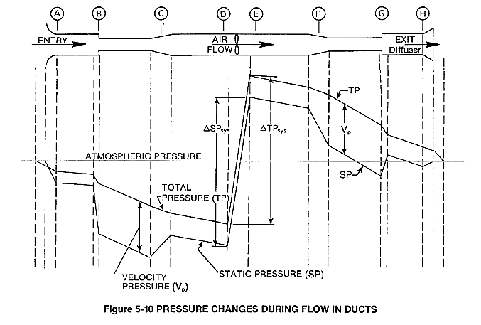
Pressure Changes
PSIM Makati HVAC Series | TECHNICAL SEMINAR
March 9,16,23 and April 13
PHILIPPINE TRADE TRAINING CENTER, PASAY CITY
Education/Study Tour Venue:
Vista Mall Sta Rosa

Slide 21
Different Methods in Duct Design
Equal friction method
- Calculates each section’s duct diameter from friction chart or databases.
2. Static Regain method
- calculates the duct diameter for each section with each
3. Constant Velocity method
PSIM Makati HVAC Series | TECHNICAL SEMINAR
March 9,16,23 and April 13
PHILIPPINE TRADE TRAINING CENTER, PASAY CITY
Education/Study Tour Venue:
Vista Mall Sta Rosa

Slide 22
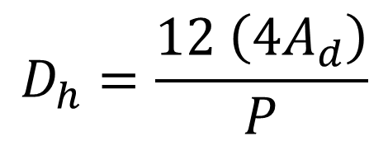
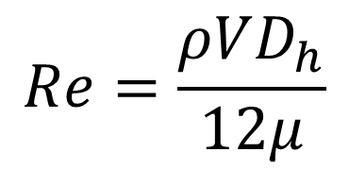
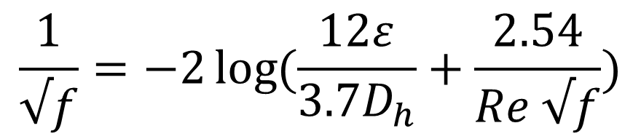
Solving the Darcy Equation
To calculate the resistance of straight duct, including the friction factor “f”, the equations are as follows;
$$\frac{1}{√f}=−2\log{(\frac{12ε}{3.7D_{h}}+\frac{2.54}{Re √f})}$$
Hydraulic Diameter
Reynold’s Number
$$D_{h}=\frac{12 \left(4A_{d}\right)}{P}$$
$$Re=\frac{ρVD_{h}}{12μ}$$
PSIM Makati HVAC Series | TECHNICAL SEMINAR
March 9,16,23 and April 13
PHILIPPINE TRADE TRAINING CENTER, PASAY CITY
Education/Study Tour Venue:
Vista Mall Sta Rosa

Slide 23
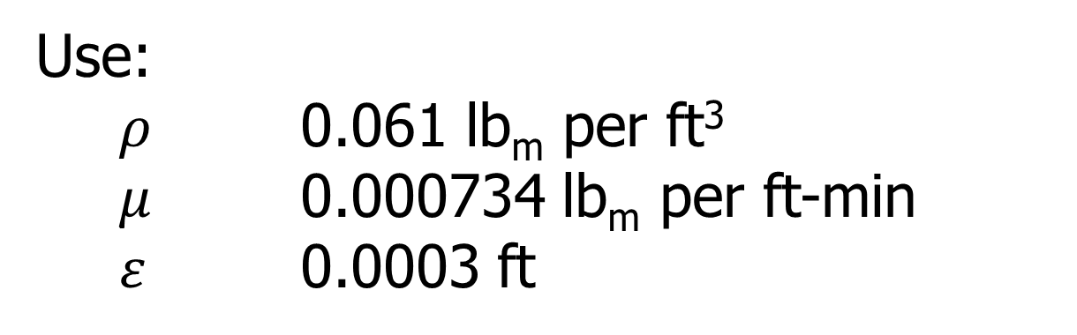
Solving the Darcy Equation
Determine the friction loss of 20’ of Ø22” spiral round duct at an airflow rate of 5000 cfm with an elevation of 5400 ft above sea level.
Use:
$ρ$ 0.061 lb_{m} per ft³
$μ$ 0.000734 lb_{m} per ft-min
$ε$ 0.0003 ft
PSIM Makati HVAC Series | TECHNICAL SEMINAR
March 9,16,23 and April 13
PHILIPPINE TRADE TRAINING CENTER, PASAY CITY
Education/Study Tour Venue:
Vista Mall Sta Rosa

Slide 24
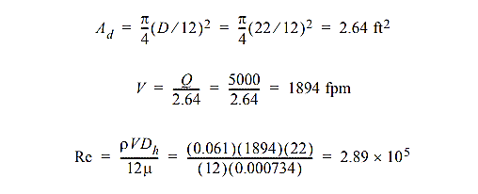
Solving the Darcy Equation
Determine the friction loss of 20’ of Ø22” spiral round duct at an airflow rate of 5000 cfm with an elevation of 5400 ft above sea level.
Solution:
PSIM Makati HVAC Series | TECHNICAL SEMINAR
March 9,16,23 and April 13
PHILIPPINE TRADE TRAINING CENTER, PASAY CITY
Education/Study Tour Venue:
Vista Mall Sta Rosa

Slide 25
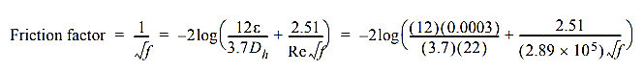
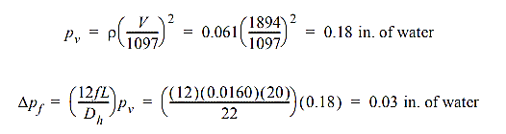
Solving the Darcy Equation
Determine the friction loss of 20’ of Ø22” spiral round duct at an airflow rate of 5000 cfm with an elevation of 5400 ft above sea level.
f = 0.0160
PSIM Makati HVAC Series | TECHNICAL SEMINAR
March 9,16,23 and April 13
PHILIPPINE TRADE TRAINING CENTER, PASAY CITY
Education/Study Tour Venue:
Vista Mall Sta Rosa

Slide 26
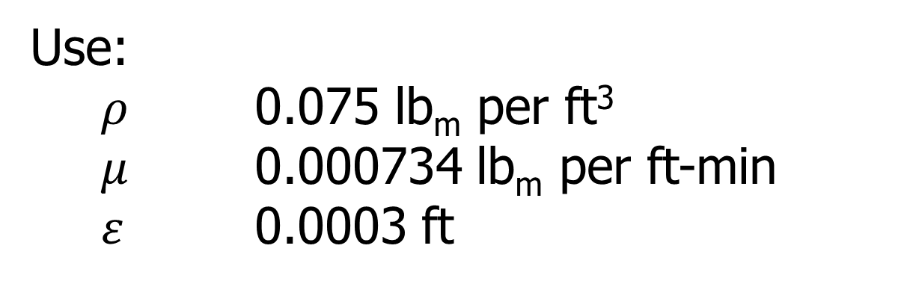
Solving the Darcy Equation
Determine the friction loss of 20’ of Ø22” spiral round duct at an airflow rate of 5000 cfm at sea level pressure.
(70F / 0%RH or 68F / 50% RH)
Use:
$ρ$ 0.075 lb_{m} per ft³
$μ$ 0.000734 lb_{m} per ft-min
$ε$ 0.0003 ft
PSIM Makati HVAC Series | TECHNICAL SEMINAR
March 9,16,23 and April 13
PHILIPPINE TRADE TRAINING CENTER, PASAY CITY
Education/Study Tour Venue:
Vista Mall Sta Rosa

Slide 27
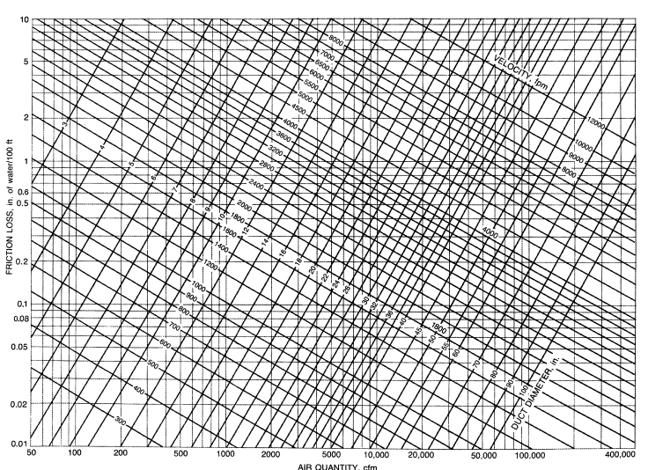
PSIM Makati HVAC Series | TECHNICAL SEMINAR
March 9,16,23 and April 13
PHILIPPINE TRADE TRAINING CENTER, PASAY CITY
Education/Study Tour Venue:
Vista Mall Sta Rosa

Slide 28
Actual Calculation of ESP
PSIM Makati HVAC Series | TECHNICAL SEMINAR
March 9,16,23 and April 13
PHILIPPINE TRADE TRAINING CENTER, PASAY CITY
Education/Study Tour Venue:
Vista Mall Sta Rosa

Slide 29
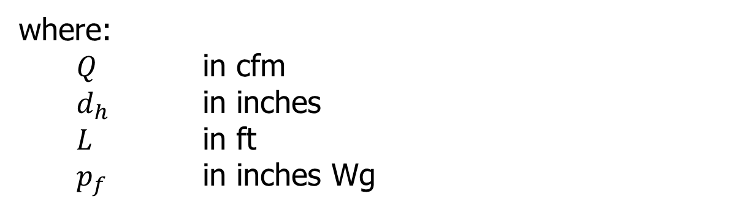

Using the Manual Calculation/Spreadsheet
If the density is within the standard sea level pressure, determination of friction loss by hand:
$p_{f}={\left( \frac{Q}{3.12 {\left(d_{h}\right)}^{2.63}}\right)}^{2}\left(\frac{L}{100}\right)$
where:
$Q$ in cfm
$d_{h}$ in inches
$L$ in ft
$p_{f}$ in inches Wg
PSIM Makati HVAC Series | TECHNICAL SEMINAR
March 9,16,23 and April 13
PHILIPPINE TRADE TRAINING CENTER, PASAY CITY
Education/Study Tour Venue:
Vista Mall Sta Rosa

Slide 30
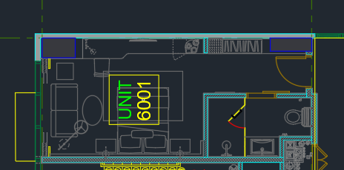
External Static Pressure (ESP)
Ventilation Calculation
5 CFM per person
10 pax per 1000 ft²
Q = 5 x (10 / 1000) x 344.48
Q = 17.22 cfm
0.06 cfm per ft²
Q = 0.06 x 344.48
Q = 20.67
PSIM Makati HVAC Series | TECHNICAL SEMINAR
March 9,16,23 and April 13
PHILIPPINE TRADE TRAINING CENTER, PASAY CITY
Education/Study Tour Venue:
Vista Mall Sta Rosa

Slide 31
External Static Pressure (ESP)
Ventilation Calculation
Qt = 17.22 + 20.67 =
= 37.89 (1.30)
= 49.26 cfm say 50 cfm
Use friction chart.
Use database.
Use spreadsheet.
PSIM Makati HVAC Series | TECHNICAL SEMINAR
March 9,16,23 and April 13
PHILIPPINE TRADE TRAINING CENTER, PASAY CITY
Education/Study Tour Venue:
Vista Mall Sta Rosa

Slide 32
External Static Pressure (ESP)
Flow Rate | Velocity | Equivalent Diameter | Duct Size (Width) | Duct Size (Height) | Aspect Ratio | Head Loss
CFM | FPM | in (mm) | in (mm) | in (mm) | - | in. Wg / 100 ft
50 | 1000 | 3 (75) | 4 (100) | 2 (50) | 2:1 | 0.720
50 | 1000 | 3 (75) | 3 (75) | 3 (75) | 1:1 | 0.496
50 | 573 | 4 (100) | 5 (125) | 3 (75) | 5:3 | 0.145
50 | 573 | 4 (100) | 4 (100) | 3 (75) | 4:3 | 0.245
50 | 573 | 4 (100) | 7 (175) | 2 (50) | 7:2 | 0.207
50 | 573 | 4 (100) | 6 (150) | 2 (50) | 3:1 | 0.289
50 | 367 | 5 (125) | 5 (125) | 4 (100) | 5:4 | 0.069
50 | 367 | 5 (125) | 7 (175) | 3 (75) | 7:3 | 0.068
PSIM Makati HVAC Series | TECHNICAL SEMINAR
March 9,16,23 and April 13
PHILIPPINE TRADE TRAINING CENTER, PASAY CITY
Education/Study Tour Venue:
Vista Mall Sta Rosa

Slide 33
Consideration of Surface Area
Equivalent Diameter | Duct Size (Width) | Duct Size (Height) | Aspect Ratio | Head Loss | Surface Area
in (mm) | in (mm) | in (mm) | - | in. Wg / 100 ft | in² (mm²)
3 (75) | 4 (100) | 2 (50) | 2:1 | 0.720 | 12 (300)
3 (75) | 3 (75) | 3 (75) | 1:1 | 0.496 | 12 (300)
4 (100) | 5 (125) | 3 (75) | 5:3 | 0.145 | 16 (400)
4 (100) | 4 (100) | 3 (75) | 4:3 | 0.245 | 14 (350)
4 (100) | 7 (175) | 2 (50) | 7:2 | 0.207 | 18 (450)
4 (100) | 6 (150) | 2 (50) | 3:1 | 0.289 | 16 (400)
5 (125) | 5 (125) | 4 (100) | 5:4 | 0.069 | 18 (450)
5 (125) | 7 (175) | 3 (75) | 7:3 | 0.068 | 20 (500)
PSIM Makati HVAC Series | TECHNICAL SEMINAR
March 9,16,23 and April 13
PHILIPPINE TRADE TRAINING CENTER, PASAY CITY
Education/Study Tour Venue:
Vista Mall Sta Rosa

Slide 34
Selection of Duct Size
Check the lowest friction or pressure drop in the table of duct sizes.
Consider the material used in each duct sizes (this includes weight of the material for hangar supports).
Select the balance of friction drop and material used.
Note that, pressure drop relates to the equipment size (i.e., motor, case size, etc.) and cost.
Note that, material used relates to the duct weight, installation, and material cost.
PSIM Makati HVAC Series | TECHNICAL SEMINAR
March 9,16,23 and April 13
PHILIPPINE TRADE TRAINING CENTER, PASAY CITY
Education/Study Tour Venue:
Vista Mall Sta Rosa

Slide 35
Presentation of ASHRAE Database
Presentation of Duct Fittings
Presentation of Various Duct Fitting Drawing
PSIM Makati HVAC Series | TECHNICAL SEMINAR
March 9,16,23 and April 13
PHILIPPINE TRADE TRAINING CENTER, PASAY CITY
Education/Study Tour Venue:
Vista Mall Sta Rosa

Slide 36
Simulations-Based Design for Duct Design and Terminal Location
Follow me on LinkedIn
Scan the code using
LinkedIn Mobile
Engr. NICK JOHNSONN FERNANDEZ
Technical Committee Member, PSIM Makati
Partner Consultant, RBSanchez PME Consultants and Associates, Inc.
Technical Design & Operations Consultant, Metallurgical and Mining
PSIM Makati HVAC Series | TECHNICAL SEMINAR
March 9,16,23 and April 13
PHILIPPINE TRADE TRAINING CENTER, PASAY CITY
Education/Study Tour Venue:
Vista Mall Sta Rosa
Technical Seminar Partners:

Slide 37
Learning Objectives:
To apply and size duct works using software such as advanced spreadsheets, ASHRAE database.
To learn how to use LISP in ductwork drafting.
To utilize dwg drawings to increase productivity on duct sizing and ESP determination.
To understand the proper duct design related to terminal selection and location.
PSIM Makati HVAC Series | TECHNICAL SEMINAR
March 9,16,23 and April 13
PHILIPPINE TRADE TRAINING CENTER, PASAY CITY
Education/Study Tour Venue:
Vista Mall Sta Rosa

Slide 38
Actual Simulation, Drafting Techniques and Presentation
PSIM Makati HVAC Series | TECHNICAL SEMINAR
March 9,16,23 and April 13
PHILIPPINE TRADE TRAINING CENTER, PASAY CITY
Education/Study Tour Venue:
Vista Mall Sta Rosa

Slide 39
Simulations-Based Design for Pipe Design
Follow me on LinkedIn
Scan the code using
LinkedIn Mobile
Engr. NICK JOHNSONN FERNANDEZ
Technical Committee Member, PSIM Makati
Partner Consultant, RBSanchez PME Consultants and Associates, Inc.
Technical Design & Operations Consultant, Metallurgical and Mining
PSIM Makati HVAC Series | TECHNICAL SEMINAR
March 9,16,23 and April 13
PHILIPPINE TRADE TRAINING CENTER, PASAY CITY
Education/Study Tour Venue:
Vista Mall Sta Rosa
Technical Seminar Partners:

Slide 40
Learning Objectives:
To apply and size pipe works using basic numerical simulation and other pipe design software such as Fluid Flow.
To learn how to utilize the software to size up pipes with selected pumps or indicated initial flow requirement
To improve the pipe layout drafting to augment the manual design pipe size calculations.
PSIM Makati HVAC Series | TECHNICAL SEMINAR
March 9,16,23 and April 13
PHILIPPINE TRADE TRAINING CENTER, PASAY CITY
Education/Study Tour Venue:
Vista Mall Sta Rosa

Slide 41
Actual Simulation, Drafting Techniques and Presentation
PSIM Makati HVAC Series | TECHNICAL SEMINAR
March 9,16,23 and April 13
PHILIPPINE TRADE TRAINING CENTER, PASAY CITY
Education/Study Tour Venue:
Vista Mall Sta Rosa

Slide 42
Question and Answer?
PSIM Makati HVAC Series | TECHNICAL SEMINAR
March 9,16,23 and April 13
PHILIPPINE TRADE TRAINING CENTER, PASAY CITY
Education/Study Tour Venue:
Vista Mall Sta Rosa
Technical Seminar Partners:

Slide 43
Thank You!
Follow me on LinkedIn
Scan the code using
LinkedIn Mobile
PSIM Makati HVAC Series | TECHNICAL SEMINAR
March 9,16,23 and April 13
PHILIPPINE TRADE TRAINING CENTER, PASAY CITY
Education/Study Tour Venue:
Vista Mall Sta Rosa
Technical Seminar Partners:

